Slide 1

Cloud enabled Altair 8800
Dave Glover
Microsoft Cloud Developer Advocate
@dglover
Search: IoT Tech Community
GitHub: https://github.com/AzureSphereCloudEnabledAltair8800

Slide 2
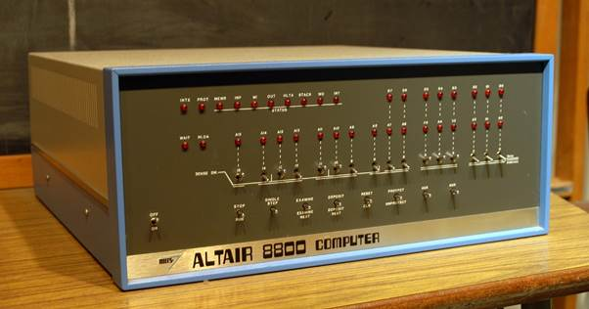

Slide 3
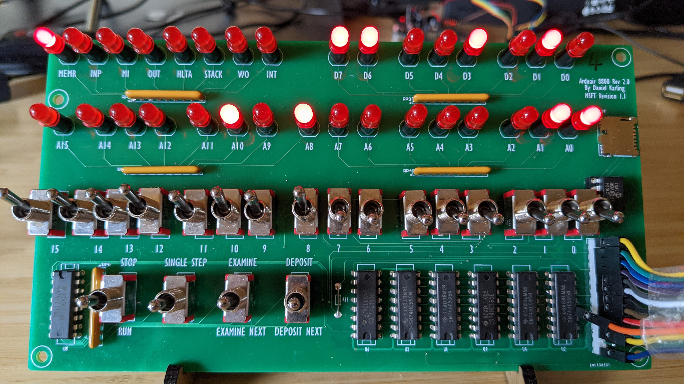

Slide 4
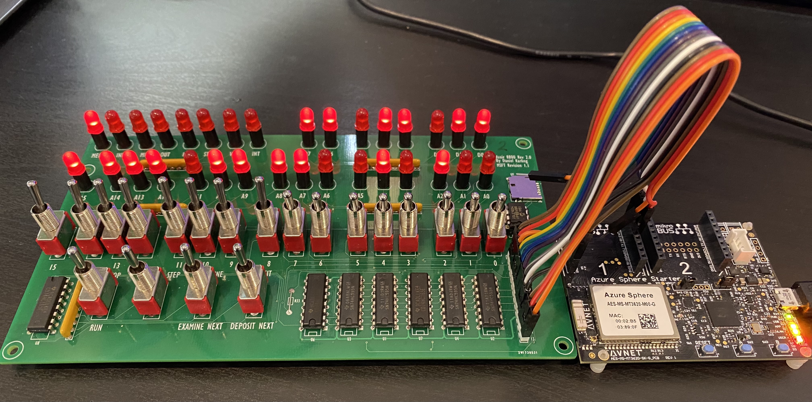

Slide 5
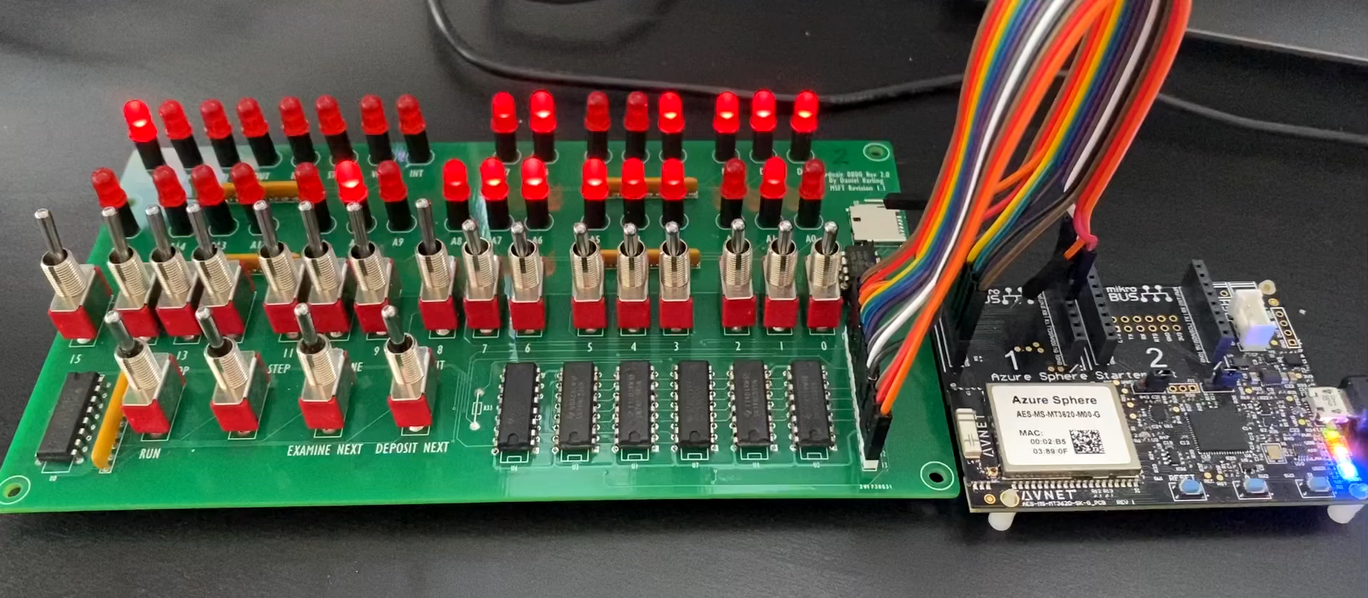

Slide 6
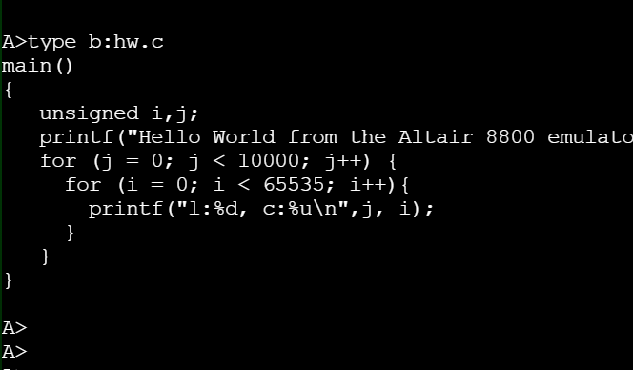
Altair 8800 Emulator on Azure Sphere
Azure Sphere
Azure Cloud Services
Web Terminal
Cortex A7
Intercore Bridge
Cortex M4
Azure IoT Central
HTML/CSS/JavaScript
Custom applications
Configuration and Reporting
Virtual disk cache
BASIC, C, Assembler
Azure Static Web App
Altair BASIC
CPM 2.2
Altair Web Terminal
Intel 8080 Emulator
Cortex M4
Azure VM
Terminal IO
Virtual Disk
SD Card
Service
Virtual disk server over MQTT
MQTT & Azure IoT C SDK
Xterm.js
MQTT Broker
(Mosquitto)
Azure Sphere OS
MQTT.js
Internet

Slide 7
Altair 8800 Emulator on Azure Sphere
Azure Sphere
Cortex A7
Intercore Bridge
Cortex M4
Custom applications
Virtual disk cache
BASIC, C, Assembler
Altair BASIC
CPM 2.2
Intel 8080 Emulator
Cortex M4
Terminal IO
Virtual Disk
SD Card
Service
MQTT & Azure IoT C SDK
Azure Sphere OS

Slide 8
Virtual File System Disk Sector Cache and Server
Azure Sphere
Azure Cloud Services
Cortex A7
Intercore Bridge
Cortex M4
Azure VM
Custom applications
Virtual disk server over MQTT
Cache-Aside virtual disk 800 sector cache (LRU)
sector
sector
sector
sector
sector
sector
BASIC, C, Assembler
sector
sector
sector
sector
sector
sector
sector
sector
sector
sector
sector
sector
sector
sector
sector
sector
Altair BASIC
CPM 2.2
sector
sector
sector
sector
sector
sector
sector
sector
sector
sector
sector
sector
sector
sector
sector
sector
sector
sector
sector
sector
sector
sector
Intel 8080 Emulator
sector
sector
sector
sector
sector
sector
sector
sector
sector
sector
1
sector
sector
sector
sector
sector
sector
Terminal IO
Virtual Disk
?
sector
sector
sector
sector
sector
sector
sector
sector
sector
sector
sector
sector
sector
sector
sector
sector
3
sector
sector
sector
sector
MQTT Client
sector
sector
sector
sector
MQTT Broker
(Mosquitto)
Azure Sphere OS
Determine if disk sector in cache
If sector is not in cache request sector from virtual disk server
Store a copy of sector in the cache
2
Internet

Slide 9
Altair 8800 Emulator on Azure Sphere
Azure Sphere
Azure Cloud Services
Web Terminal
Cortex A7
Intercore Bridge
Cortex M4
Azure Static Web App
HTML/CSS/JavaScript
Custom applications
Virtual disk cache
Altair Web Terminal
BASIC, C, Assembler
Authentication providers
Azure AD, Google, Facebook, GitHub
Altair BASIC
CPM 2.2
Intel 8080 Emulator
Cortex M4
Terminal IO
Virtual Disk
SD Card
Service
Azure VM
Xterm.js
MQTT Client
MQTT Broker
(Mosquitto)
Azure Sphere OS
MQTT.js
Internet
stdin: Subscribes to altair/<channel_id>/dev
stdout: Publishes on altair/<channel_id>/web
stdin: Subscribes to altair/<channel_id>/web
stdout: Publishes on altair/<channel_id>/dev

Slide 10
Security Patterns with MQTT
DAA and Mosquitto

Slide 11

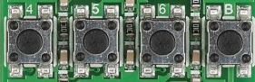

Slide 12
Altair 8800 Emulator on Azure Sphere
Azure Sphere
Cortex A7
Intercore Bridge
Cortex M4
Custom applications
Virtual disk cache
BASIC, C, Assembler
Altair BASIC
CPM 2.2
Intel 8080 Emulator
Cortex M4
Terminal IO
Virtual Disk
SD Card
Service
MQTT & Azure IoT C SDK
Azure Sphere OS

Slide 13
Altair on Azure Sphere Web Terminal
Azure Sphere
MQTT Broker
Web Terminal
Cortex A7
Intercore Bridge
Cortex M4
test.mosquitto.org
HTML/CSS/JavaScript
Custom applications
Virtual disk cache
MQTT Broker
test.mosquitto.org
BASIC, C, Assembler
Altair BASIC
CPM 2.2
Intel 8080 Emulator
Cortex M4
Terminal IO
Virtual Disk
SD Card
Service
MQTT & Azure IoT C SDK
Xterm.js
Azure Sphere OS
MQTT.js
Internet

